Slide 1
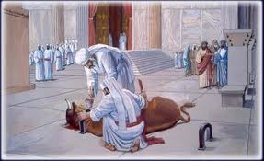
Worship

Slide 2
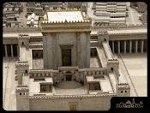
Worship – Jesus changed everything
Perfect priest
Perfect offering
Giving perfect access
See book of Hebrews especially chapters 8-10

Slide 3
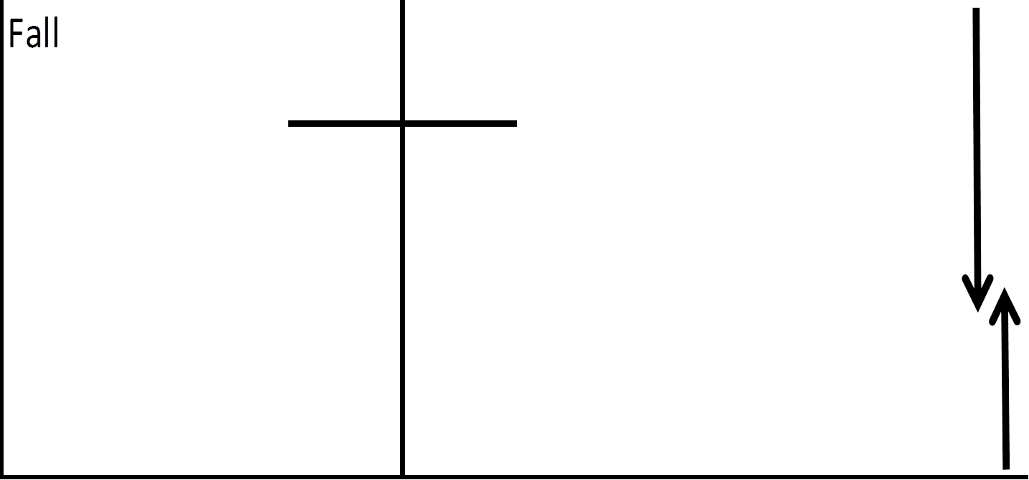
Worship Our fellowship offering
Leviticus 3
Romans 12-13
“Therefore, I urge you, brothers, in view of God’s mercy to offer your bodies as a living sacrifice, holy and pleasing to God” 12v1
Perfect priest made the perfect offering giving perfect access

Slide 4
Logical Worship
“which is your reasonable service” NKJV
Logikos
Latreuo
“to offer your bodies as a living sacrifice, holy and pleasing to God -
this is your true and proper worship.”
Perfect priest made the perfect offering giving perfect access

Slide 5
Living Sacrifices – our logical worship
Jesus changes everything
Mercy changes everything

Slide 6
Living Sacrifices – our logical worship
Repentance (metanoia)
- A change of mind
“Do not conform to the pattern of this world, but be transformed by the renewing of your mind.” Romans 12v2
Mercy changes everything

Slide 7
Living Sacrifices – wonderful outcome
“that you may love the Lord your God, listen to his voice, and hold fast to him. For the Lord is your life” Deut 30v20
“that you may prove what is that good and acceptable and perfect will of God.” 12v2 NKJV
God’s will is best – our lives can show it

Slide 8
What does this worship affect?
Everything – not just 30 minutes of singing
Attitude to self and my gifts – Rom 12v3-8
“Do not think of yourself more highly than you ought” v3
Unity in diversity – “we have different gifts according to the grace given us”v6
“If it is serving let him serve”
“If it is teaching let him teach”
Use the gifting to edify the body

Slide 9
What does this worship affect?
Attitude to self and my gifts – Rom 12v3-8
Attitude to the body (church) – Rom 12v9-21
“Love must be sincere. Hate what is evil; cling to what is good. ¹⁰ Be devoted to one another in love. Honour one another above yourselves.”
We must love our brothers – esteem them
We must hate evil in the church
Application – we can worry about our esteem and other people’s sin

Slide 10
What does this worship affect?
Attitude to self and my gifts – Rom 12v3-8
Attitude to the body (church) – Rom 12v9-21
Attitude to authority – Rom 13v1-7
¹ “Let everyone be subject to the governing authorities, for there is no authority except that which God has established.”
⁷ Give to everyone what you owe them: if you owe taxes, pay taxes; if revenue, then revenue; if respect, then respect; if honour, then honour.

Slide 11
What does this worship affect?
Everything – not just 30 minutes of singing
Attitude to self and my gifts – Rom 12v3-8
Attitude to the body (church) – Rom 12v9-21
Attitude to authority – Rom 13v1-7
Attitude to God’s Standards - Rom 13v8-14
“Let us behave decently, as in the daytime, not in carousing and drunkenness, not in sexual immorality and debauchery, not in dissension and jealousy.” Rom 13v13

Slide 12
Living Sacrifices – lives on the altar
One boy’s offering

Slide 13
Logical worship Rom 12v1-2
Therefore, I urge you, brothers, in view of God’s mercy, to offer your bodies as a living sacrifice, holy and pleasing to God – this is your true and proper worship.² Do not conform to the pattern of this world, but be transformed by the renewing of your mind. Then you will be able to test and approve what God’s will is – his good, pleasing and perfect will.

Slide 14
Living Sacrifices – our logical worship
Repentance (metanoia)
- A change of mind
“Do not conform to the pattern of this world, but be transformed by the renewing of your mind.” Romans 12v2
How should our transformation show?

